Slide 1
BUG SQUASHERS
Client Server program using UDP sockets:
- JAYASREE (1818128)
RAJASREE (1818146)

Slide 2
Aim:
To write a python program to implement Client Server communication using UDP sockets.

Slide 3
Procedure
SERVER SIDE:

Slide 4
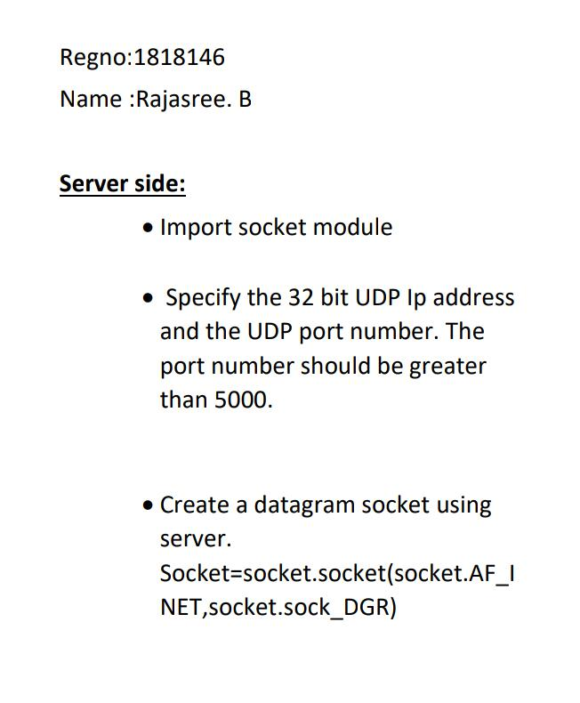
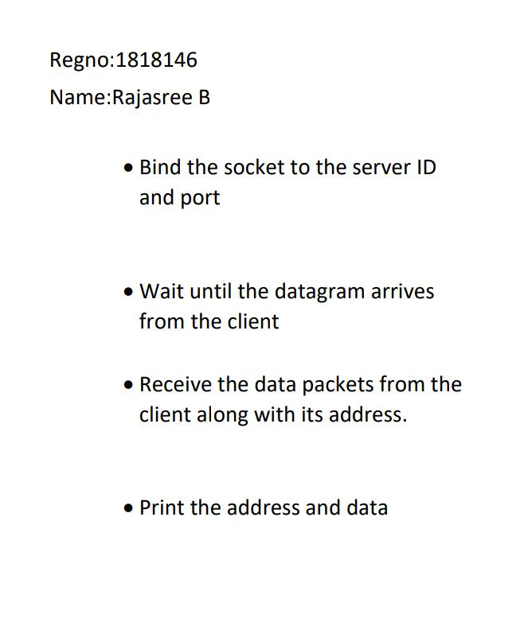

Slide 5
Procedure
CLIENT SIDE:

Slide 6
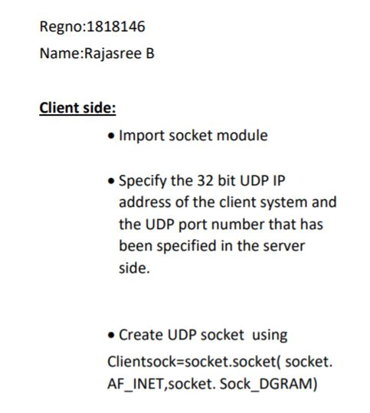
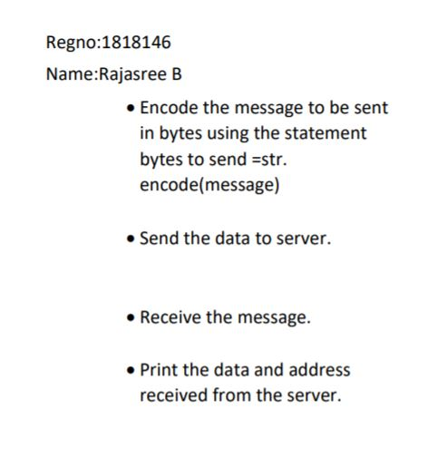

Slide 7
import socket
UDP_IP_ADDRESS ="127.0.0.1"
UDP_PORT_NO = 6789
serverSock = socket.socket(socket.AF_INET, socket.SOCK_DGRAM)
serverSock.bind((UDP_IP_ADDRESS, UDP_PORT_NO))
print("Server is waiting!")
while True:
data, addr = serverSock.recvfrom(1024)
print ("Message: ", data)
SERVER SIDE PROGRAM:

Slide 8
import socket
UDP_IP_ADDRESS ="192.168.43.93"
UDP_PORT_NO = 6789
Message = ("Hello, Server!")
bytesToSend = str.encode(Message)
clientSock = socket.socket(socket.AF_INET, socket.SOCK_DGRAM)
clientSock.sendto(bytesToSend, (UDP_IP_ADDRESS, UDP_PORT_NO))
CLIENT SIDE PROGRAM:

Slide 9
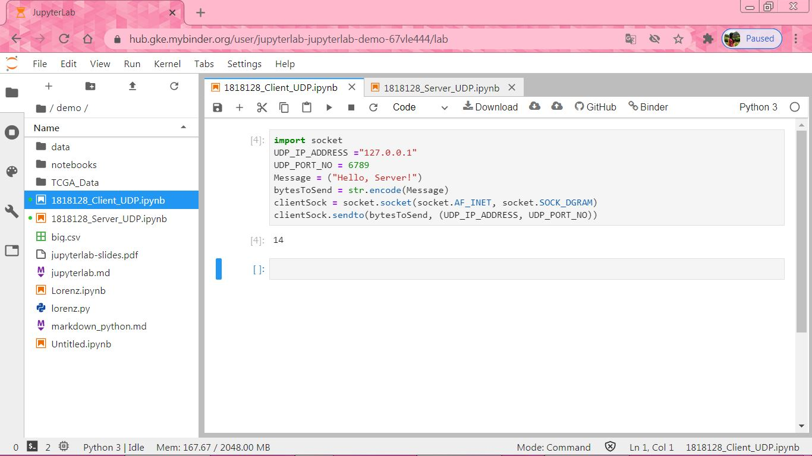
CLIENT SIDE OUTPUT:

Slide 10
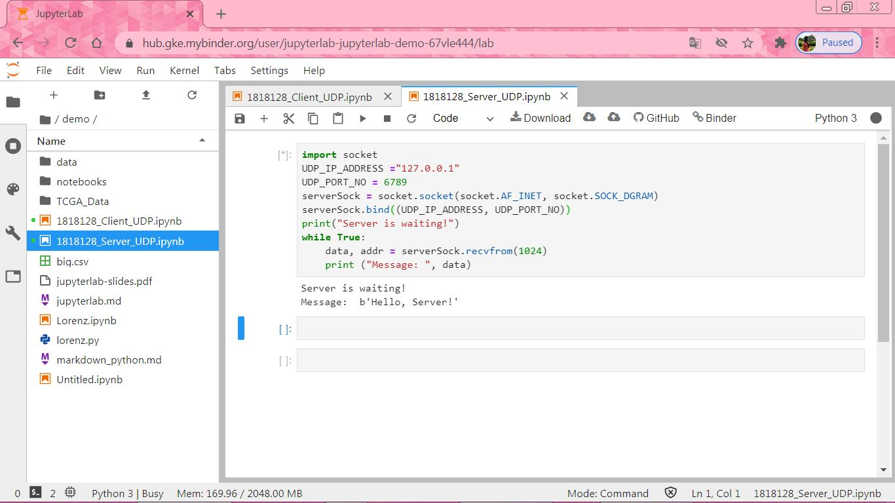
SERVER SIDE OUTPUT:

Slide 11
Result:
Thus the python program to implement Client Server communication using UDP sockets was executed successfully.

